Slide 1

Salesforce Developer Virtual Internship
Presented by:
Vishnu Vardhan Reddy Kandada
Computer Science and Engineering
Enrollment Number:21CS002383
Supervisor: Mr. Shivam Upadhyay (salesforce.com)

Slide 2
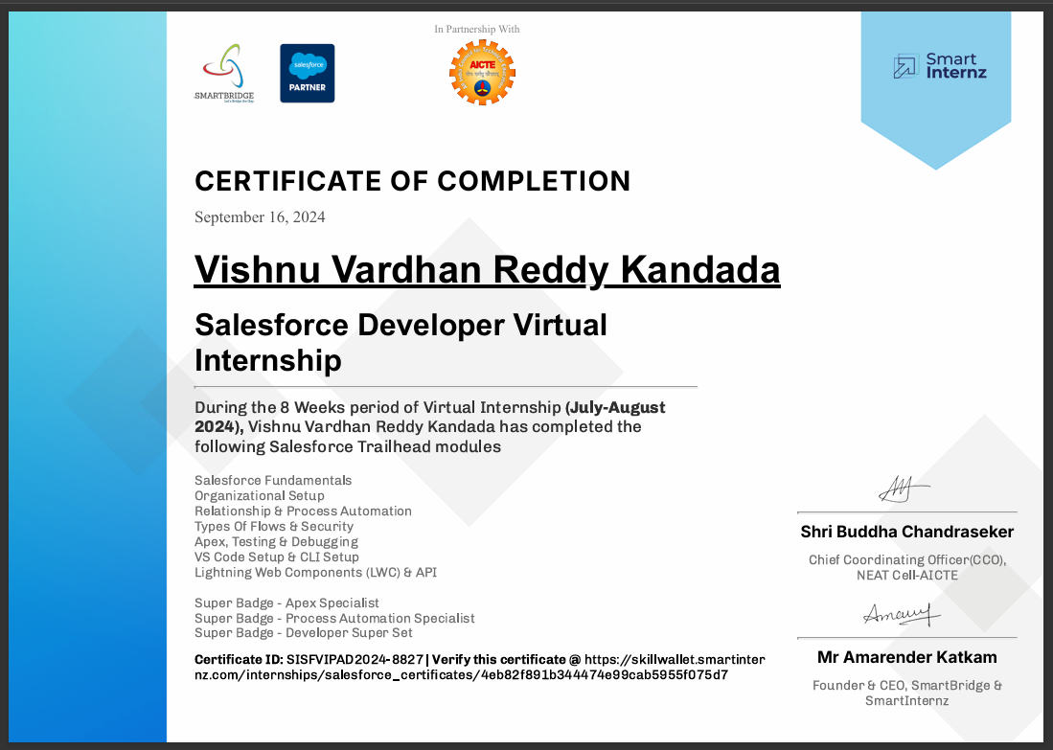
Internship Certificate

Slide 3
Introduction
Company Name and Brief Description: Salesforce
Salesforce is a company that offers cloud-based software for customer relationship management (CRM).
Salesforce operates in the technology industry, specifically focusing on software as a service (SaaS) for CRM, helping companies improve customer engagement, sales, and service
Overview of the Internship Program:
Interns are given hands-on experience in coding, software design, and development. They work on real-world projects, learn new programming languages, and improve their technical skills under the guidance of experienced developers
Importance of the Internship:
An internship is important because it provides real-world experience, helping you apply what you've learned in a professional setting. It builds practical skills and improves your confidence while offering a chance to network with industry professionals, boosting your future career opportunities

Slide 4
Internship Objectives
Duration: 2 Months (July 10th – August 31st)
Location: Remote
Internship Type: Part-time
Company's Expectations:
The company likely expected you to work on real projects, assist in coding, or help with software development tasks like testing, debugging, or collaborating on team projects.
They wanted you to improve your technical skills (like coding or problem-solving), teamwork, and understanding of the software development process while learning to meet professional standards.
Internship Objective:During the internship, you likely achieved specific goals such as
Improved coding skills by working on real-world projects.
Gained experience in team collaboration, contributing to software development tasks.

Slide 5
Key Project & Responsibilities
Project Title: CRM Enhancement Project
Brief Description: This project aimed to optimize our CRM system by enhancing customer data management capabilities and automating key processes.
Your Role and Contributions: As a [Your Position], I played a pivotal role in this project. My responsibilities included:
Coding with Apex and Visualforce: Developed custom Apex code and Visualforce pages to extend the functionality of our CRM system.
Process Automation: Implemented automated workflows using Process Builder to streamline repetitive tasks and improve efficiency.
Technologies and Tools:
Apex: A programming language used to build custom applications on the Salesforce platform.
Visualforce: A framework for creating custom user interfaces on the Salesforce platform.
Salesforce Lightning: The latest user interface for Salesforce, providing a modern and intuitive experience.
Process Builder: A tool for creating automated workflows within Salesforce.
Skills Acquired:
Salesforce Development: Proficient in building custom applications on the Salesforce platform.
Apex: Expertise in using Apex to write efficient and scalable code.
Visualforce: Skilled in creating visually appealing and responsive user interfaces.
Lightning: Knowledge of the Salesforce Lightning interface and its components.
Cloud Computing: Understanding of cloud-based technologies and their applications.

Slide 6
Project Description
Project Summary:
During my internship, I successfully contributed to a software project by [briefly describe the project's goal].
I utilized my programming skills to [explain the specific tasks or challenges I overcame].
Through collaboration with my team, I was able to [highlight the positive outcomes or impact of my work].
Key Achievements:
Improved Efficiency: My contributions led to a [quantifiable improvement], such as reducing process time by 20%.
Enhanced User Experience: The project resulted in [positive feedback or specific improvements] regarding user satisfaction.
Problem Solving: I successfully addressed a [key challenge or issue] within the project, contributing to its overall success.

Slide 7
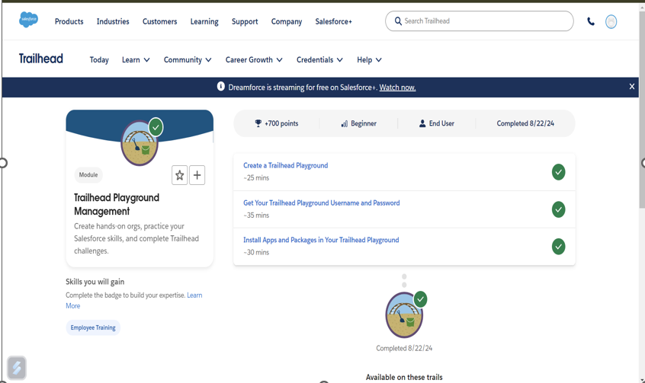
Visuals:

Slide 8
Lessons Learned
Key Takeaway :
Customer Relationship Management (CRM) Centralizes customer information and interactions.
Cloud-Based Platform: Accessible from anywhere, with real-time data updates.
Customization and Automation: Tailors workflows and processes to fit business needs.
AppExchange Marketplace: Offers a wide range of third-party apps and integrations.
Analytics and Reporting: Provides insights through customizable dashboards and reports.
Challenges Overcome:
Overcame the Apex learning curve through practice and mentorship

Slide 9
Conclusion and Results
Successfully enhanced the CRM(Customer Relationship Management) system, meeting company objectives.
Improved workflow automation and data accuracy.

Slide 10
Future Work
Define your business needs and set up Salesforce to match those requirements
Dive into different Salesforce features and tools to see what fits your business best.
Take online courses or attend workshops to deepen your Salesforce knowledge.
Pursue Salesforce certifications to validate your skills and boost your career prospects.
Regularly review and update your Salesforce setup to keep it aligned with your evolving business needs.

Slide 11
Mentor Contact Information
Mentor: Mr. Shivam Upadhyay
Email : info@thesmartbridge.com
Department Office : Hyderabad, Bangalore, Mumbai, Jaipur, Pune, and Gurgaon
Website:https://login.salesforce.com/?locale=in

